Slide 1

Commercial Floor Systems
We shape our buildings; thereafter they shape us. -Winston Churchill
Civil Engineering and Architecture
© 2010 Project Lead The Way, Inc.

Slide 2
Commercial Floor Systems
Ground Floor
  Slab-on-Grade
Elevated Floor
  Precast Concrete
  Cast-in-Place Concrete
Concrete Floor Design
  Load-Span Tables
Notes:
Civil Engineering and Architecture
Unit 3 – Lesson 3.1 – Commercial Building Systems
Project Lead The Way, Inc.
Copyright 2010
Commercial Floor Systems

Slide 3
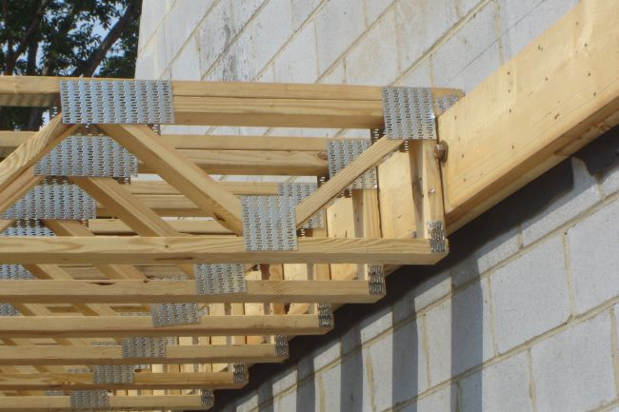
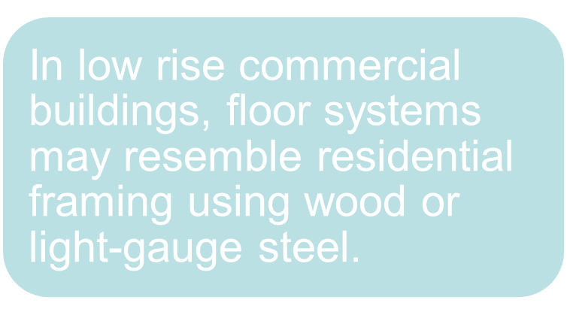
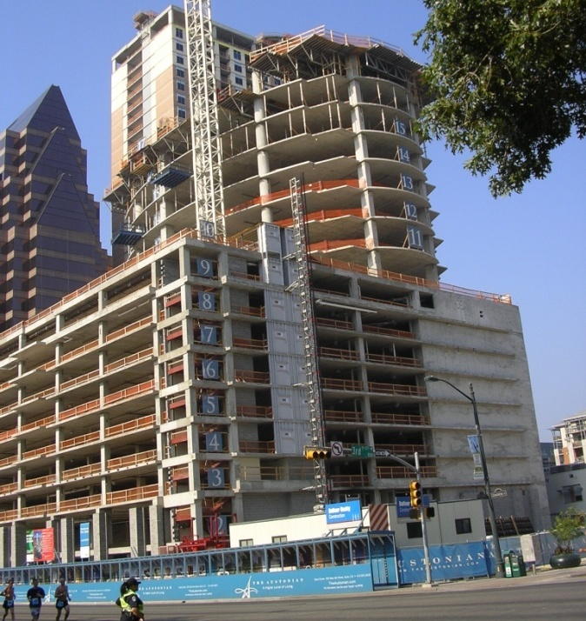
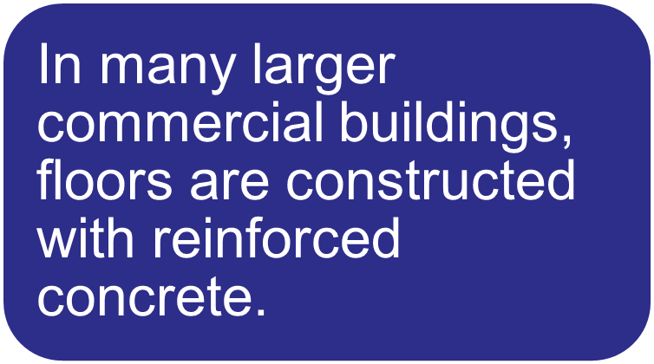
Commercial Floor Systems
Courtesy Carolina Concrete Masonry Association
Notes:
Builders use tongue and groove CDX plywood or OSB Oriented Strand Board as sheathing.
Civil Engineering and Architecture
Unit 3 – Lesson 3.1 – Commercial Building Systems
Project Lead The Way, Inc.
Copyright 2010
Commercial Floor Systems

Slide 4
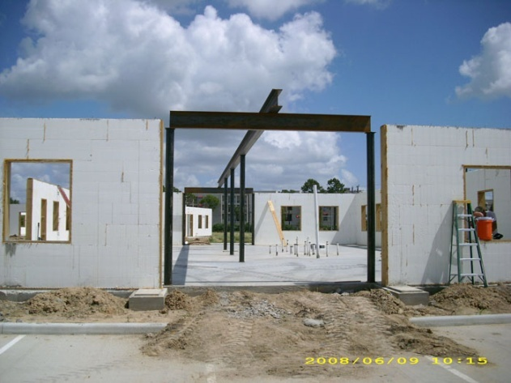
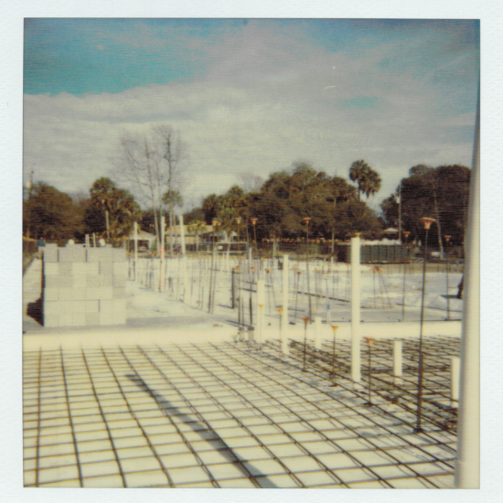
Commercial Ground Floor
Slab on Grade
Cast-in-place concrete slab poured directly on the ground
Reinforced with steel bars and/or welded wire fabric (WWF)
Courtesy TexAZ Commercial Park
Courtesy Isle of Palms, SC Recreation Department
Welded wire fabric (WWF) is placed before slab pour
Notes:
Concrete floors can be reinforced with reinforcement bar or wire mesh.
Steel reinforcing is strong in tension, and so will increase the tensile strength when embedded in concrete.
Welded Wire Fabric is typically used to resist surface cracking due to shrinkage and temperature changes.
Civil Engineering and Architecture
Unit 3 – Lesson 3.1 – Commercial Building Systems
Project Lead The Way, Inc.
Copyright 2010
Commercial Floor Systems

Slide 5
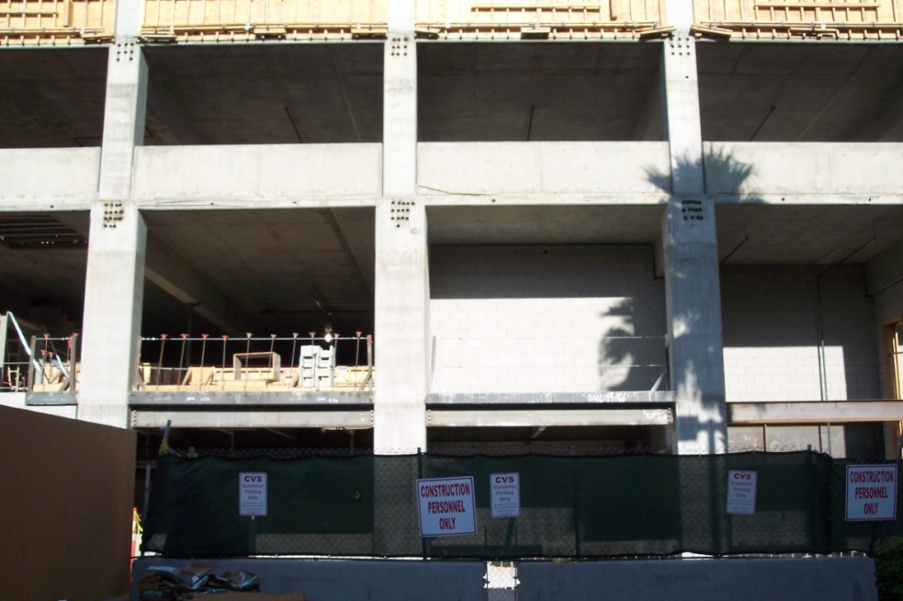
Commercial High Rise Floors
Elevated Floors
Floors above the ground
Typical construction
  Precast Concrete
  Cast-in-Place Concrete
No permission
Notes:
This photograph shows elevated cast in place concrete floors and walls. Notice the formwork for the next wall pour at the top of the photograph.
Civil Engineering and Architecture
Unit 3 – Lesson 3.1 – Commercial Building Systems
Project Lead The Way, Inc.
Copyright 2010
Commercial Floor Systems

Slide 6
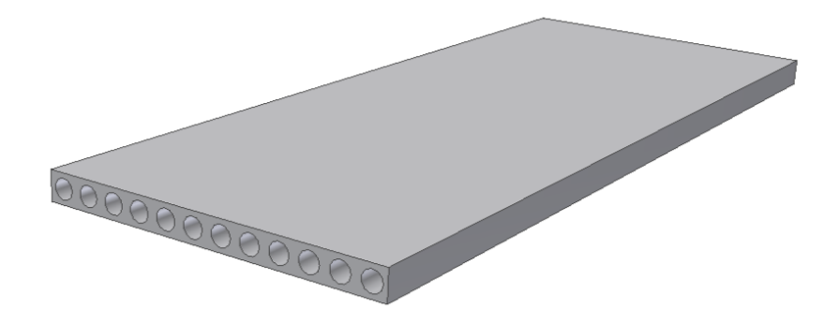
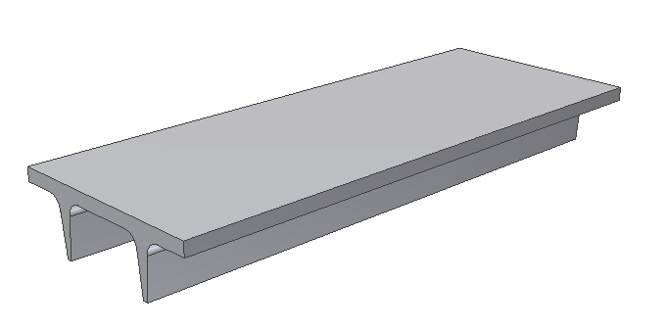
Precast Concrete Floor
Formed and cast off-site
Transported to the site
Installed in the structure
Typical Shapes
  Hollow core
  T or Double T
Hollow Core Precast floor panels
Double T Precast slab
Notes:
Precast concrete is a common method when constructing parking structures. Precast shapes are formed off site and shipped to the building for assembly.
Civil Engineering and Architecture
Unit 3 – Lesson 3.1 – Commercial Building Systems
Project Lead The Way, Inc.
Copyright 2010
Commercial Floor Systems

Slide 7

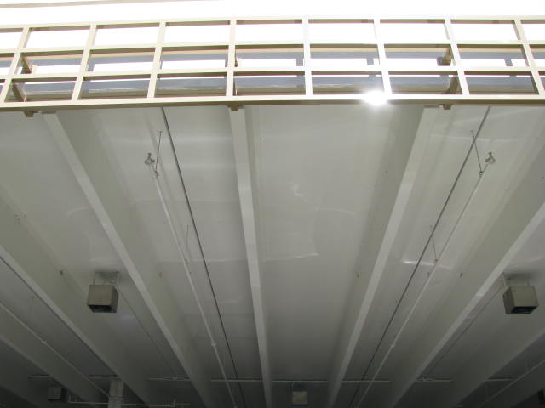
Precast Concrete Floor
Courtesy Portland Cement Association
Courtesy Eric Fisher
Using precast concrete floors can reduce both construction cost and build time.
Notes:
The image on the left shows a construction worker installing a hollow core concrete floor panel.
The picture on the right shows a floor system of a parking garage constructed from double T precast panels.
Civil Engineering and Architecture
Unit 3 – Lesson 3.1 – Commercial Building Systems
Project Lead The Way, Inc.
Copyright 2010
Commercial Floor Systems

Slide 8
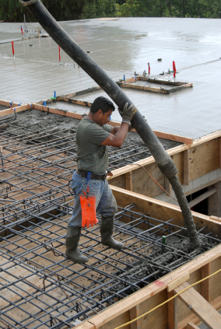
Cast-in-Place Concrete
Concrete floors are formed, reinforced, and cast in place.
©iStockphoto.com
Notes:
Civil Engineering and Architecture
Unit 3 – Lesson 3.1 – Commercial Building Systems
Project Lead The Way, Inc.
Copyright 2010
Commercial Floor Systems

Slide 9
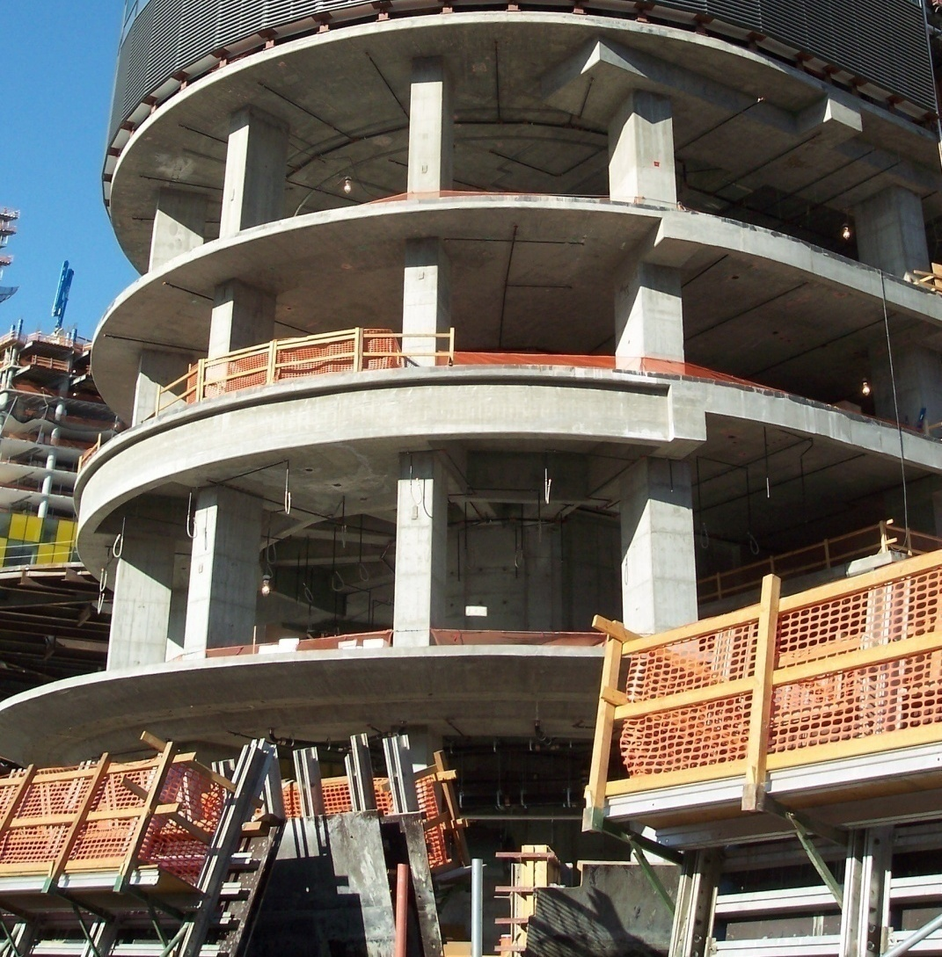
Cast-in-Place Concrete Floor
Cast-in-place floors provide flexibility in building shape.
Notes:
Civil Engineering and Architecture
Unit 3 – Lesson 3.1 – Commercial Building Systems
Project Lead The Way, Inc.
Copyright 2010
Commercial Floor Systems

Slide 10
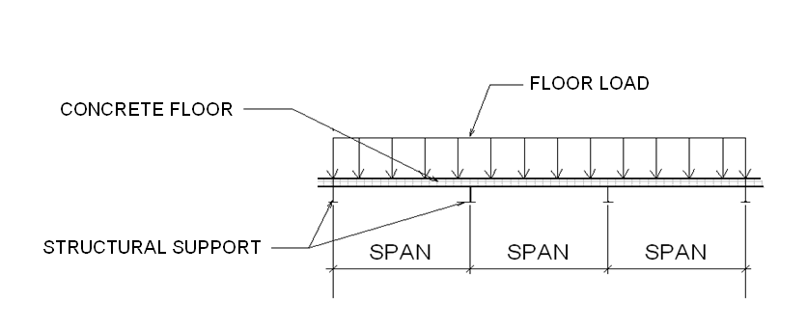
Concrete Floor Design
Concrete floors are designed to carry a given applied load over a span.
  Load = The force that is applied to the floor
  Typically expressed as pounds per square foot of floor.
  Example: 150 psf
  Span = The distance between supports
Notes:
Civil Engineering and Architecture
Unit 3 – Lesson 3.1 – Commercial Building Systems
Project Lead The Way, Inc.
Copyright 2010
Commercial Floor Systems

Slide 11
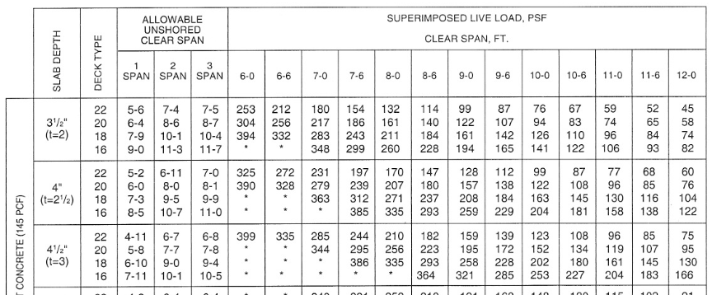
Concrete Floor Design
Structural engineers often use load-span tables to select structural elements.
Based on the applied (superimposed live) load and the span, you can choose the floor design that requires the least amount of materials.
Span
Load
Notes:
Civil Engineering and Architecture
Unit 3 – Lesson 3.1 – Commercial Building Systems
Project Lead The Way, Inc.
Copyright 2010
Commercial Floor Systems

Slide 12
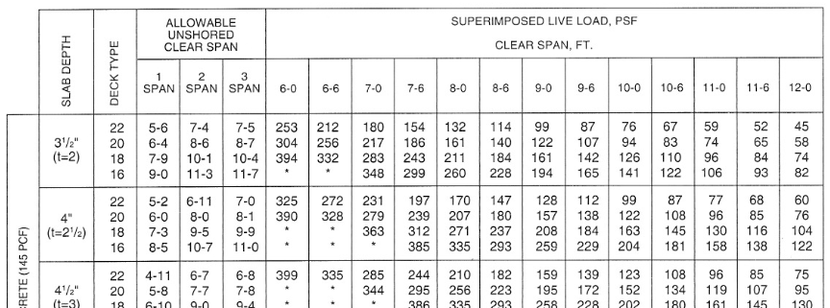
Concrete Floor Design Example
PROBLEM: Choose the most efficient composite floor
slab to span 8ft 6in. and carry an applied load of 220 psf.
Span
Applied load must be less than tabulated load
Choose the smallest slab depth that will carry the load.
Use a 3.5 inch slab on Deck Type16 (16 gauge metal).
Notes:
Civil Engineering and Architecture
Unit 3 – Lesson 3.1 – Commercial Building Systems
Project Lead The Way, Inc.
Copyright 2010
Commercial Floor Systems

Slide 13
Concrete Floor Design Example
Be sure to check the Allowable Unshored Clear Span.
Notes:
The Allowable Unshored Clear Span is the longest distance that the deck can safely carry before the slab has cured and hardened without providing additional support.
If additional support is needed, shoring can be provided. Shoring consists of structural support members that hold up the decking while the slab is being constructed and cured. Shoring is removed once the slab has reached an acceptable strength.
Civil Engineering and Architecture
Unit 3 – Lesson 3.1 – Commercial Building Systems
Project Lead The Way, Inc.
Copyright 2010
Commercial Floor Systems

Slide 14



Concrete Floor Design Example
Avoid shoring – it adds to the cost of construction.
The number of spans is the number of unsupported lengths between supports.
Use more spans to reduce slab thickness.
1 SPAN
2 SPAN
3 SPAN
Notes:
Civil Engineering and Architecture
Unit 3 – Lesson 3.1 – Commercial Building Systems
Project Lead The Way, Inc.
Copyright 2010
Commercial Floor Systems

Slide 15
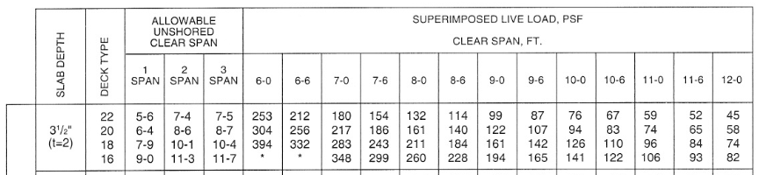
Concrete Floor Design Example
Span
The Allowable Unshored Clear Span for all cases is greater than the span and therefore does not affect the design.
Notes:
Civil Engineering and Architecture
Unit 3 – Lesson 3.1 – Commercial Building Systems
Project Lead The Way, Inc.
Copyright 2010
Commercial Floor Systems

Slide 16
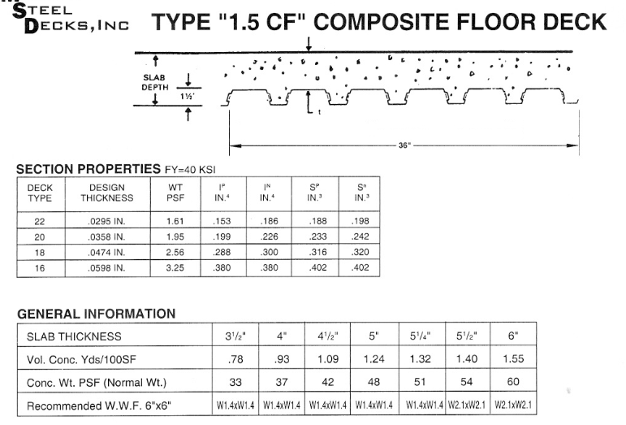
Concrete Floor Design Example
Using the technical information available from the decking manufacturer, specify 6 x 6/W1.4 x W1.4 Welded Wire Fabric reinforcement for the 3.5in. slab.
Notes:
Civil Engineering and Architecture
Unit 3 – Lesson 3.1 – Commercial Building Systems
Project Lead The Way, Inc.
Copyright 2010
Commercial Floor Systems

Slide 17
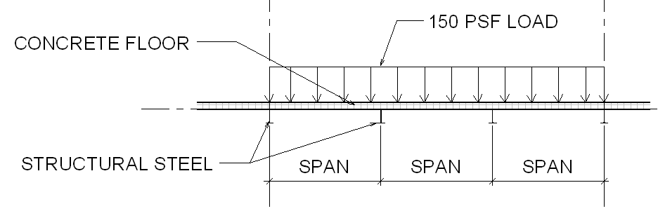
Keystone Project Floor Design
(Superimposed live) load = 150 psf
Span will depend on system chosen
Notes:
Civil Engineering and Architecture
Unit 3 – Lesson 3.1 – Commercial Building Systems
Project Lead The Way, Inc.
Copyright 2010
Commercial Floor Systems

Slide 18
Commercial Floor Systems
Ground Floor
  Slab-on-Grade
Elevated Floor
  Precast Concrete
  Cast-in-Place Concrete
Concrete Floor Design
  Load-Span Tables
Notes:
Civil Engineering and Architecture
Unit 3 – Lesson 3.1 – Commercial Building Systems
Project Lead The Way, Inc.
Copyright 2010
Commercial Floor Systems

Slide 19
References
Ching, Francis D. K., and Cassandra Adams. Building Construction Illustrated, 3rd Edition. (2000) New York: Wiley.
Ramsey, Charles George. Ramsey/Sleeper architectural graphics standards. (2000) New York: John Wiley.
Notes:
Civil Engineering and Architecture
Unit 3 – Lesson 3.1 – Commercial Building Systems
Project Lead The Way, Inc.
Copyright 2010
Commercial Floor Systems

Slide 20
Image Sources
Tilt Up Concrete Association. http://www.tilt-up.org/
iStockphoto. http://www.istockphoto.com/index.php
TexAZ Commercial Properties, LLC
Carolinas Concrete Masonry Association. http://ccmaonline.com/about-carolinas-concrete/about-us.htm
Isle of Palms Recreation Department, Isle of Palms, SC
Portland Cement Association.
Eric Fisher, Hamilton Heights High School, Arcadia, IN
Notes:
Civil Engineering and Architecture
Unit 3 – Lesson 3.1 – Commercial Building Systems
Project Lead The Way, Inc.
Copyright 2010
Commercial Floor Systems

